Slide 1
Azure Databricks Overview
Microsoft & Databricks
Partnership & GTM Architecture
February 2023

Slide 2
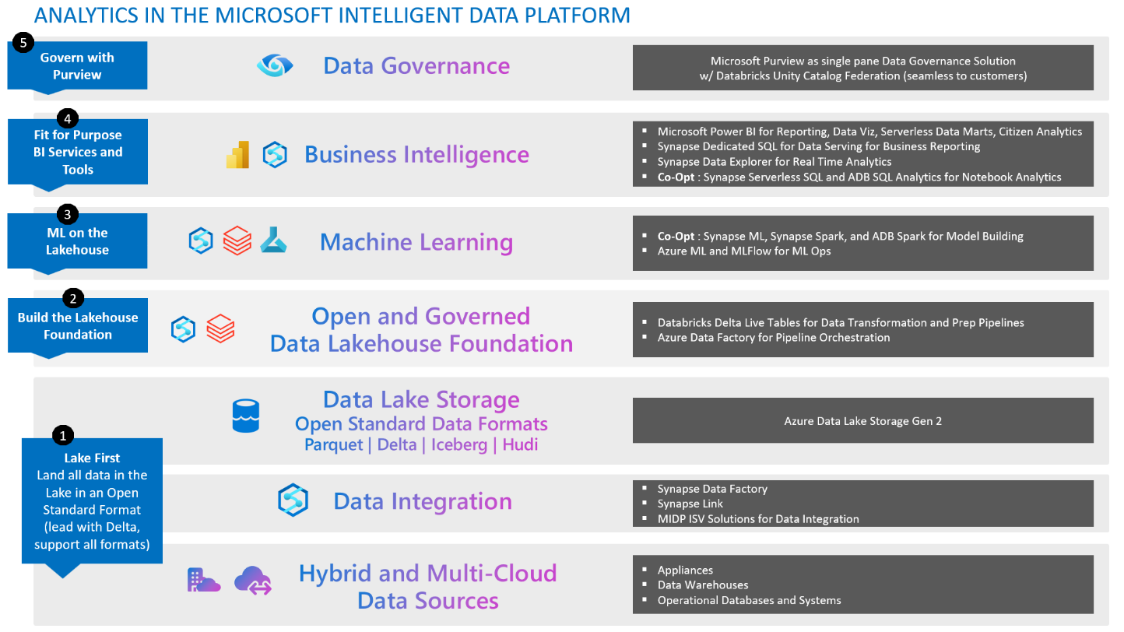

Slide 3
Azure Databricks Overview

Slide 4
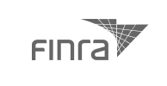























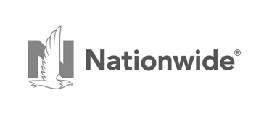







Databricks
Global adoption
Over 7000 customers, from F500 to unicorns
The Data + AI Company
Inventor and pioneer of the data lakehouse
Gartner recognized leader in both
Database Management Systems
Data Science and Machine Learning Platforms
Creator of highly successful OSS data projects: Delta Lake, Apache Spark, and MLflow
Raised over $3B in investment
4500+ employees across the globe

Slide 5






Data, analytics, and AI enabled tech’s leaders to disrupt industries

Slide 6
Tech leaders are to the right of the Data Maturity Curve
From hindsight to foresight
Automated Decision
Making
Prescriptive Analytics
Predictive Modeling
Automatically make the best decision
Competitive Advantage
Data Exploration
How should we respond?
Ad Hoc Queries
What will happen?
Reports
Clean
Data
What happened?
Data + AI Maturity

Slide 7
Most enterprises still struggle with data, analytics, and AI

Slide 8


Realizing this requires two disparate, incompatible data platforms
Data Maturity Curve
Data Warehouse
for BI
Data Lake
for AI
Automated Decision Making
Competitive Advantage
What happened?
Prescriptive Analytics
Predictive Modeling
Data Exploration
What will happen?
Ad Hoc Queries
Reports
Clean Data
Data + AI Maturity

Slide 9

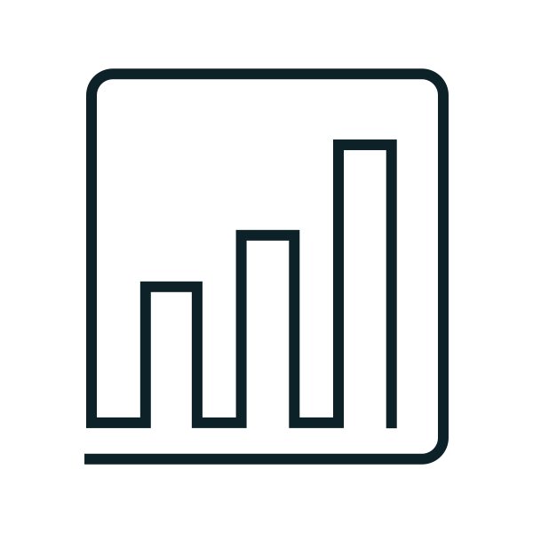
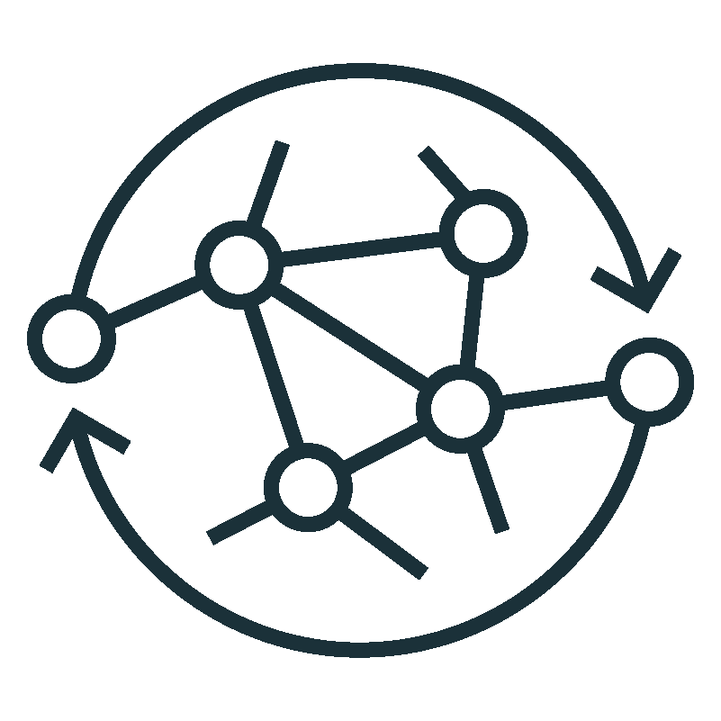


Realizing this required two disparate, incompatible data platforms
Highly reliable and efficient
All of the data and very adaptable
Business Intelligence
SQL
Analytics
Data Science
& ML
Data Streaming
Governance and Security Table ACLs
Governance and Security
Files and Blobs
Copy subsets of data
Data Warehouse
Data Lake
Structured tables
Vast amounts of RAW data
Logs, Texts, Audio, Video, Images

Slide 10
Realizing this required two disparate, incompatible data platforms
Highly reliable and efficient
All of the data and very adaptable
Business Intelligence
SQL
Analytics
Incomplete
support for use cases
Data Science
& ML
Data Streaming
Governance and Security Table ACLs
Incompatible security and governance models
Governance and Security
Files and Blobs
Copy subsets of data
Disjointed and duplicative data silos
Data Warehouse
Data Lake
Structured tables
Vast amounts of RAW data
Logs, Texts, Audio, Video, Images

Slide 11

There is no need to have two disparate platforms
Highly reliable and efficient
Data Science
& ML
Data Streaming
All of the data and very adaptable
Incomplete
support for use cases
Data Science
& ML
Data Streaming
Business Intelligence
SQL
Analytics
Business Intelligence
SQL
Analytics
Governance and Security Table ACLs
Incompatible security and governance models
Governance and Security
Files and Blobs
Governance and Security
Files and Blobs and Table ACLs
Copy subsets of data
Disjointed and duplicative data silos
Data Warehouse
Data Lake
Structured tables and unstructured files
Structured tables
Structured and unstructured files

Slide 12
This is the lakehouse paradigm
Technologies
Data Science
& ML
Data Streaming
All ML, SQL, BI,
and Streaming use cases
Data Applications
Business Intelligence
SQL
Analytics
One security and governance approach for all data assets on all clouds
Unity Catalog
Fine-grained governance for data and AI
Governance and Security
Files and Blobs and Table ACLs
A reliable
data platform to efficiently handle all data types
Delta Lake Data reliability and performance
Data Lake
Structured tables and unstructured files

Slide 13



Databricks Lakehouse Platform
Lakehouse Platform
Data
Warehousing
Data Engineering
Data Streaming
Data Science
and ML
Simple
Unify your data warehousing and AI
use cases on a single platform
Unity Catalog Fine-grained governance for data and AI
Multicloud / cloud-native
One consistent data platform across clouds
Delta Lake
Data reliability and performance
Cloud Data Lake
All structured and unstructured data
Open
Built on open source and open standards

Slide 14

Data engineering workloads on Databricks
Data orchestration through Databricks Workflows
Delta Live Tables manage your full data pipelines
Simplifies data engineering with a curated data lake approach through Delta Lake
Notes:
Databricks Workflow is a platform for automating and orchestrating data pipelines within the Databricks ecosystem.
It provides a visual interface for defining complex workflows with multiple steps and dependencies, allowing users to manage and monitor the entire lifecycle of their data pipelines from a single place.
Workflow also provides features like scheduling, parameterization, and versioning, making it easier to manage large-scale data processing operations in a collaborative environment.

Slide 15

SQL workloads on Databricks
Great performance and concurrency for BI and SQL workloads on Delta Lake
Native SQL interface for analysts
Support for BI tools to directly query your most recent data in Delta Lake

Slide 16

ML & data science workloads on Databricks
Machine Learning
Model registry, reproducibility, productionization
Leverages Delta Lake for reproducibility
AutoML for citizen data scientists
Data Science
Collaborative notebooks and dashboards for interactive analysis
Native support for Python, Java, R, Scala
Delta Lake data natively supported

Slide 17
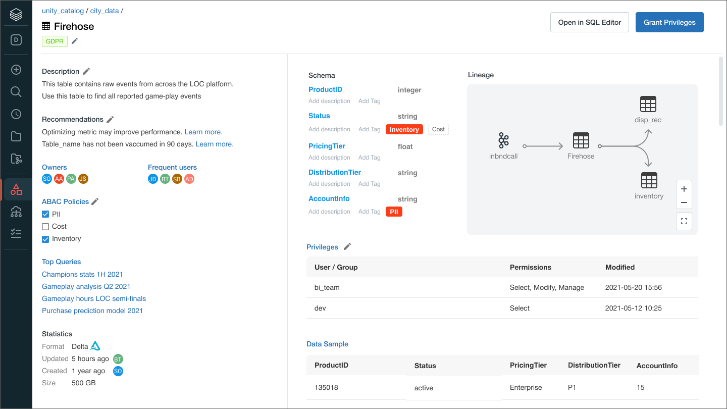
Unity Catalog for Lakehouse Governance
Govern and manage all data assets
Warehouse, Tables, Columns
Data Lake, Files
Machine Learning Models
Dashboards and Notebooks
Capabilities
Data lineage
Attribute-based access control
Security policies
Table or column level tags
Auditing
Data sharing

Slide 18
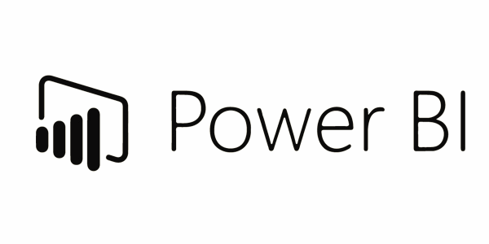
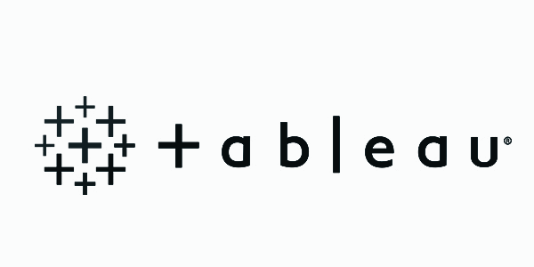


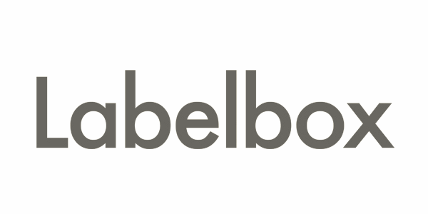






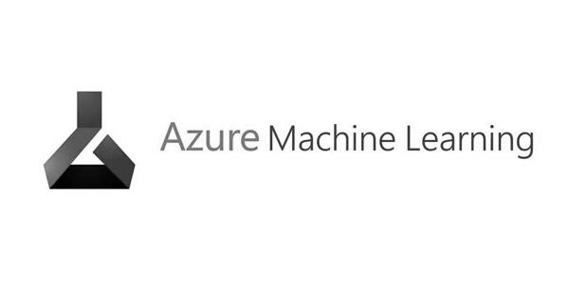
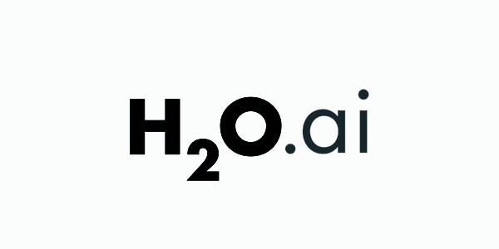





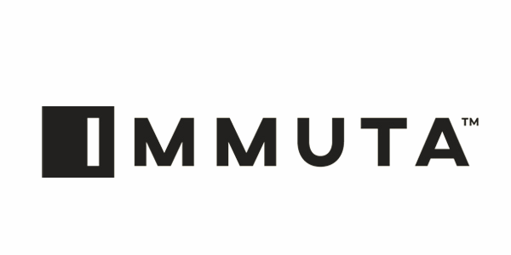







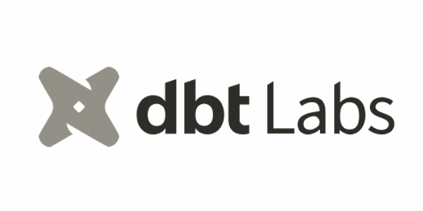

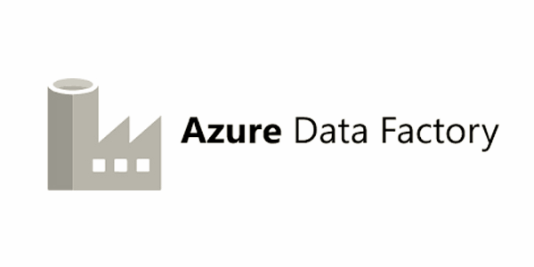






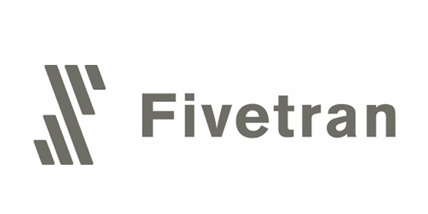



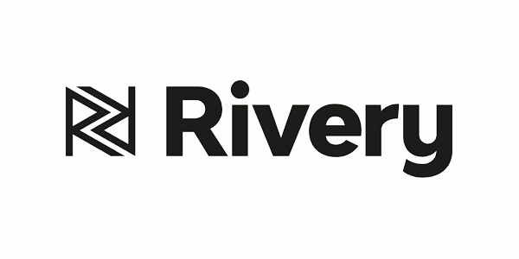






Databricks thrives within your modern data stack
BI and Dashboards
Machine Learning
Data Science
Data Governance
Data
Warehousing
Data Engineering
Data Streaming
Data Science
and ML
Consulting & SI Partners
Data Pipelines
Unity Catalog
Delta Lake
Data Ingestion
Cloud Data Lake

Slide 19
Building your Lakehouse
Solution Accelerators
Comprehensive investment into your success
Your success
Co-located Professional Services
In-person and Virtual Training
Supported by 24/7/365 global, production operations at scale

Slide 20





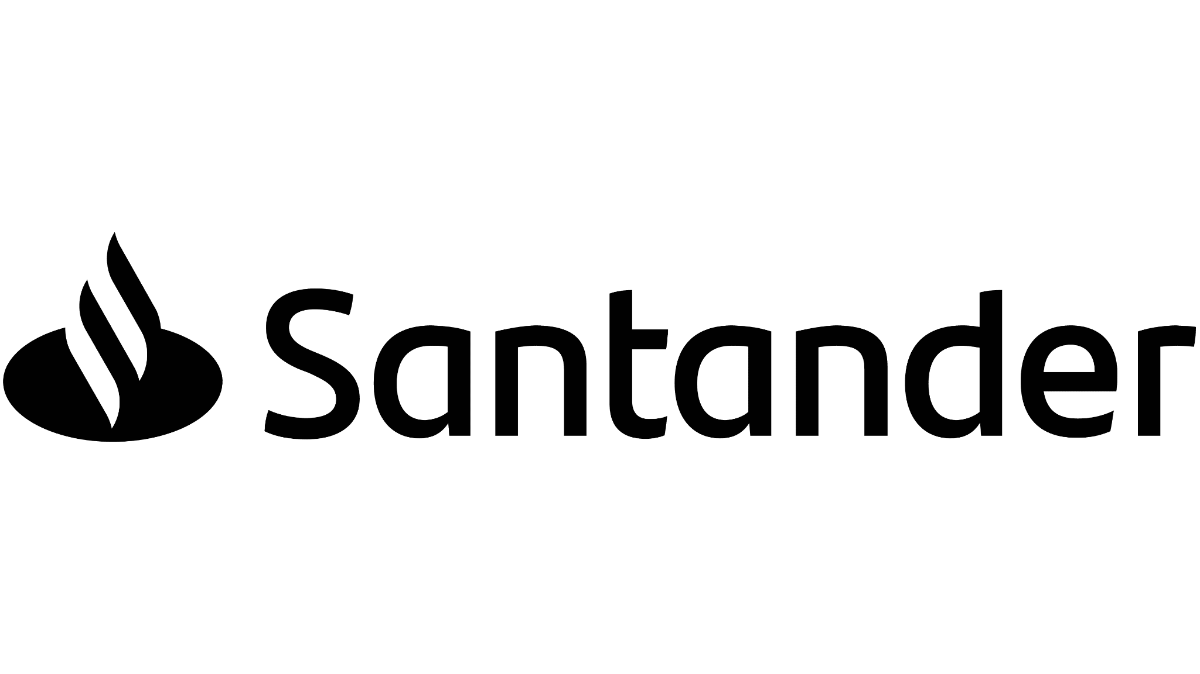




























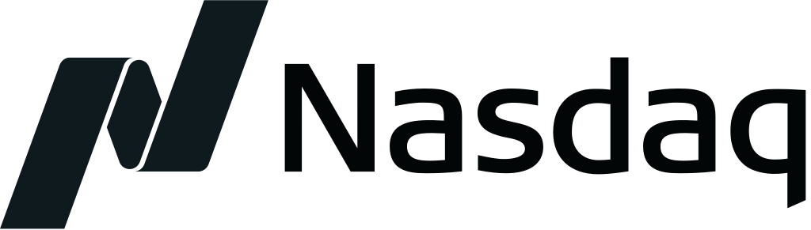


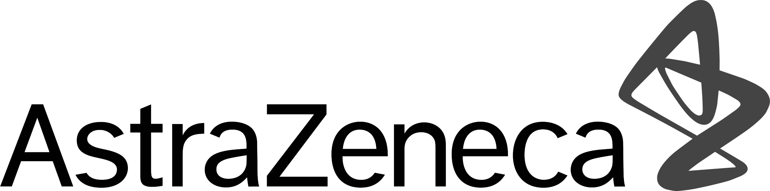










































Supporting enterprises in every industry
Healthcare & Life Sciences
Retail & CPG
Media & Entertainment
Financial Services
Public Sector
Manufacturing & Logistics
Energy & Utilities
Digital Native

Slide 21
Deployment Model and Architecture

Slide 22


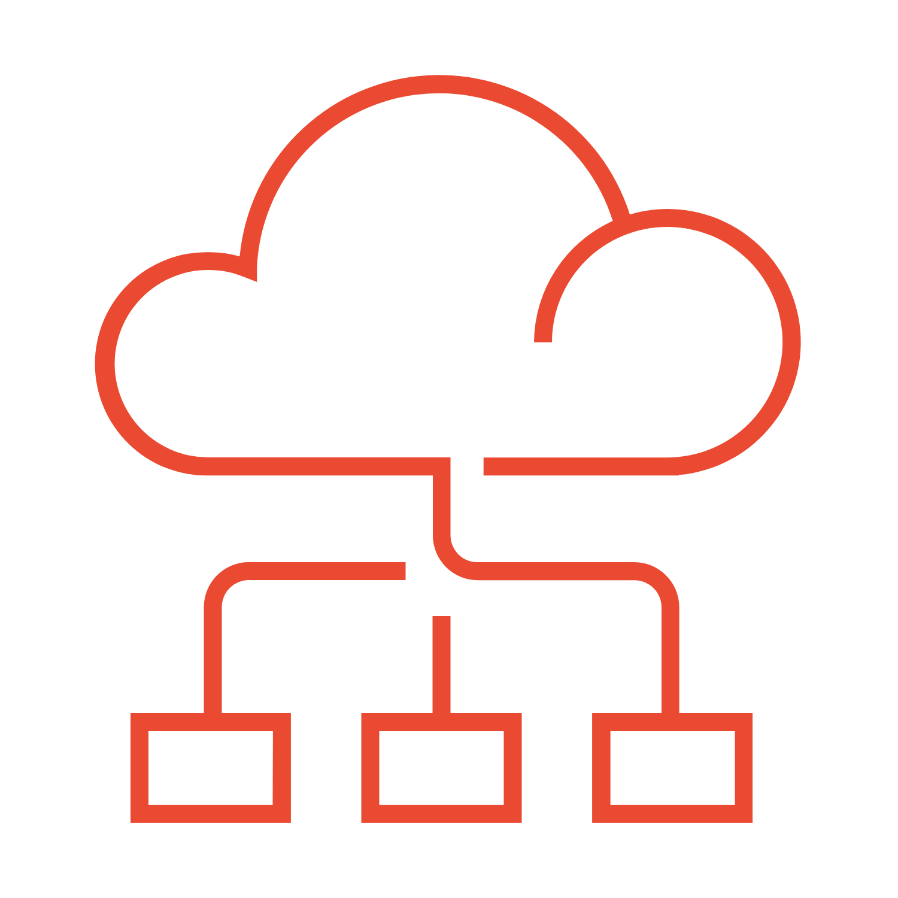
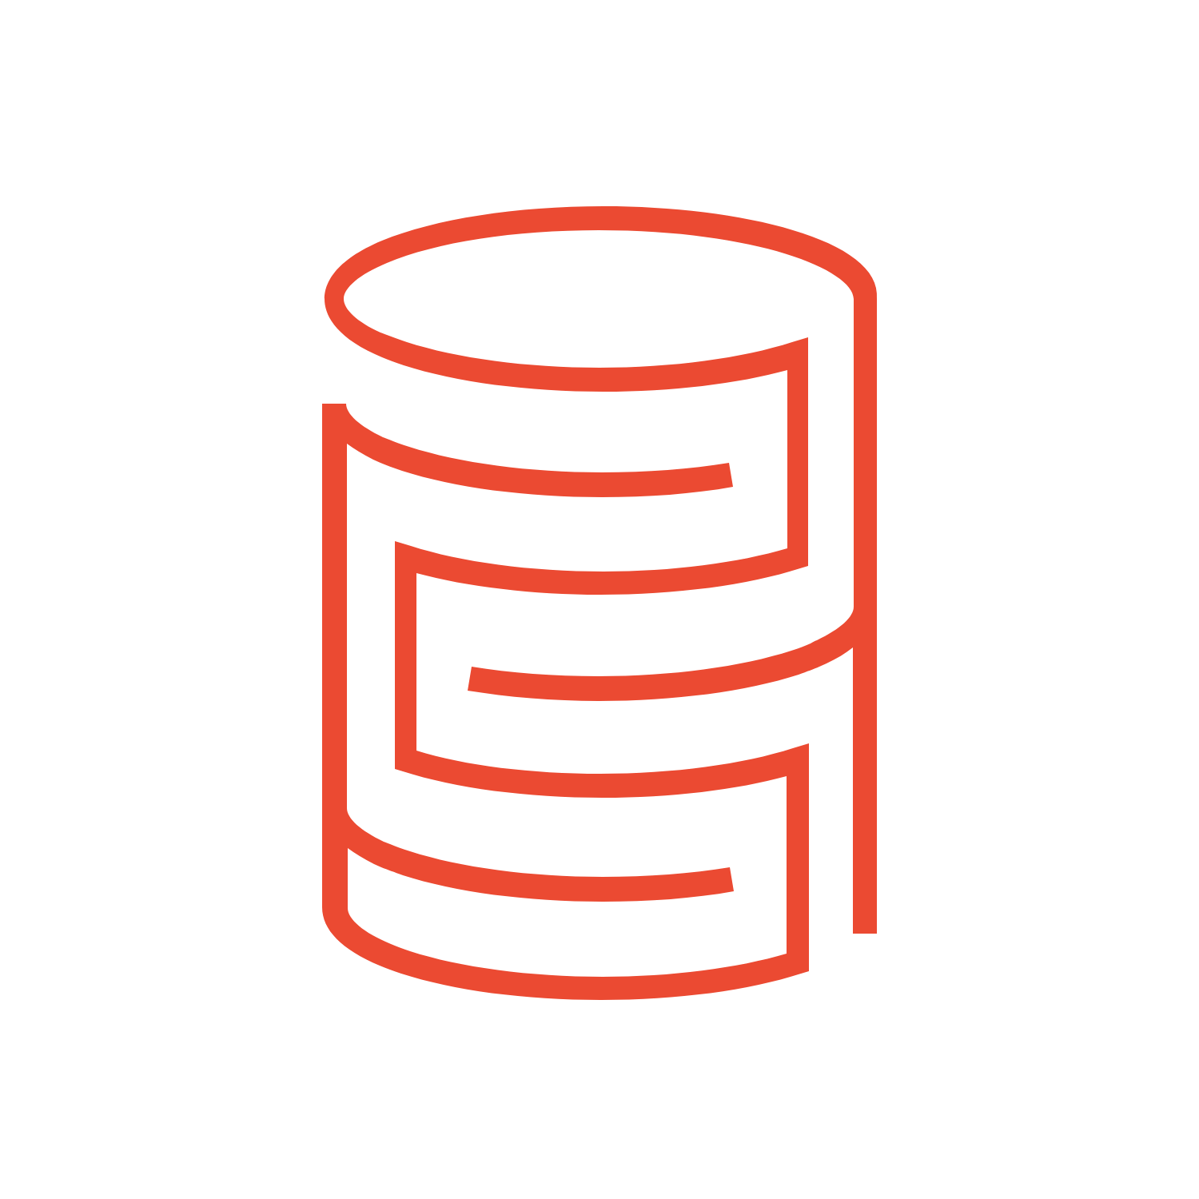
Azure Databricks Deployment
With Unity Catalog
Customer
Control Plane
Data Plane
Unity Catalog
Web App
Workflow Manager
Cluster Manager
Jobs Manager
Query Manager
*
Workspace clusters
SQL Warehouses
Account Console
Azure Databricks is a first tier Azure service
Azure Blob Storage / ADLS
DBFS
System
*
*
Cluster Manager in Control Plane
No costs when all Databricks clusters are down
Azure Portal
* Deployment triggered
Notes:
Azure Databricks deployment consists of two planes: Control Plane and Workspace Plane.
Control Plane: It is responsible for managing the underlying infrastructure and providing management services like job scheduling, metadata management, and user authentication. It is owned and managed by Microsoft.
Workspace Plane: It is where users interact with the platform, create notebooks, run jobs, visualize data, and perform other data processing tasks. It is owned by the customer and provides a customizable environment for their data processing needs.
By separating these two planes, Databricks provides a secure and scalable environment for customers to perform big data processing and analytics, while still giving them control over their own data and processing resources.

Slide 23







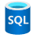



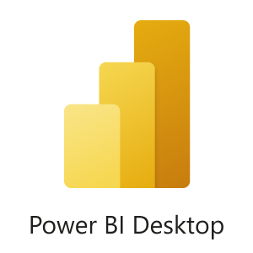



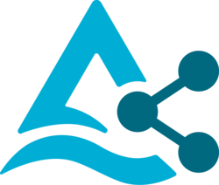

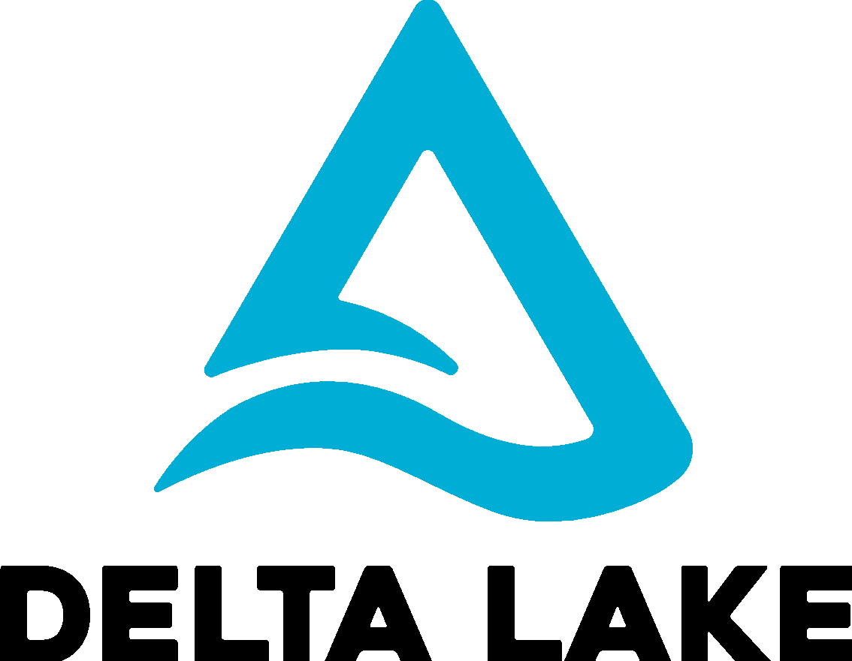
Lakehouse Reference Architecture
Source
Ingest
Transform
Query and Process
Serve
Analysis/Output
Unity Catalog
Azure Purview
Data Governance
Orchestration
Databricks Workflows
CI/CD support
MLOps Stacks
Sensors and IoT
(unstructured)
Azure IoT Hub
Data Science and ML
Model Serving
CDC
ML Runtime
Serverless Real-Time Inference
Operational Databases
Databricks Lakehouse
Apps
Azure Event Hub
AutoML
Feature Store
RDBMS (structured)
Event Hub Capture + Databricks AutoLoader
Structured Streaming
SQL DB
Media (unstructured)
Data Engineering / Engines
Data Warehousing
Delta Live Tables
Databricks SQL
Cosmos DB
Auto Loader
Photon
Serverless SQL
Files / Logs (semi-.structured)
Power BI
Data Sharing
Azure Synapse Analytics
Business Apps
(structured)
Azure Data Factory
Azure Data Lake Storage
Delta Sharing
3rd party
Other clouds
bronze
silver
gold
Storage

Slide 24
Lakehouse Reference Architecture
Source
Ingest
Transform
Query and Process
Serve
Analysis/Output
Unity Catalog
Azure Purview
Data Governance
Orchestration
Databricks Workflows
CI/CD support
MLOps Stacks
Sensors and IoT
(unstructured)
Databricks Lakehouse
RDBMS (structured)
Data Engineering / Engines
Data Warehousing
Media (unstructured)
Databricks SQL
Delta Live Tables
Power BI
Photon
Serverless SQL
Auto Loader
Files / Logs (semi-.structured)
Business Apps
(structured)
Azure Data Factory
Azure Data Lake Storage
Other clouds
bronze
silver
gold
Storage

Slide 26
Platform Demo

Slide 27
Delta Lake

Slide 28
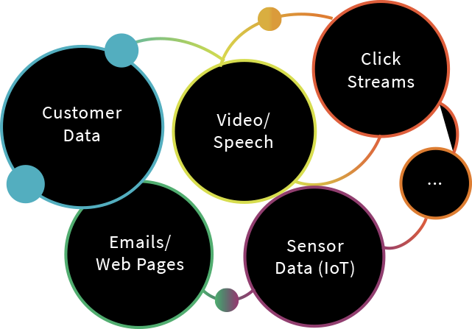
Enterprises have been spending millions of dollars getting data into data lakes
Data Lake

Slide 29
The aspiration is to do data science and ML on all that data!
Data Science & ML
Recommendation Engines
Risk, Fraud Detection
IoT & Predictive Maintenance
Genomics & DNA Sequencing
Data Lake

Slide 30
But the data is not ready for data science & ML
The majority of these projects are failing due to
unreliable data and poor performance!
Data Science & ML
Recommendation Engines
Risk, Fraud Detection
IoT & Predictive Maintenance
Genomics & DNA Sequencing
Data Lake

Slide 31
Why are these projects struggling with reliability and performance?

Slide 32
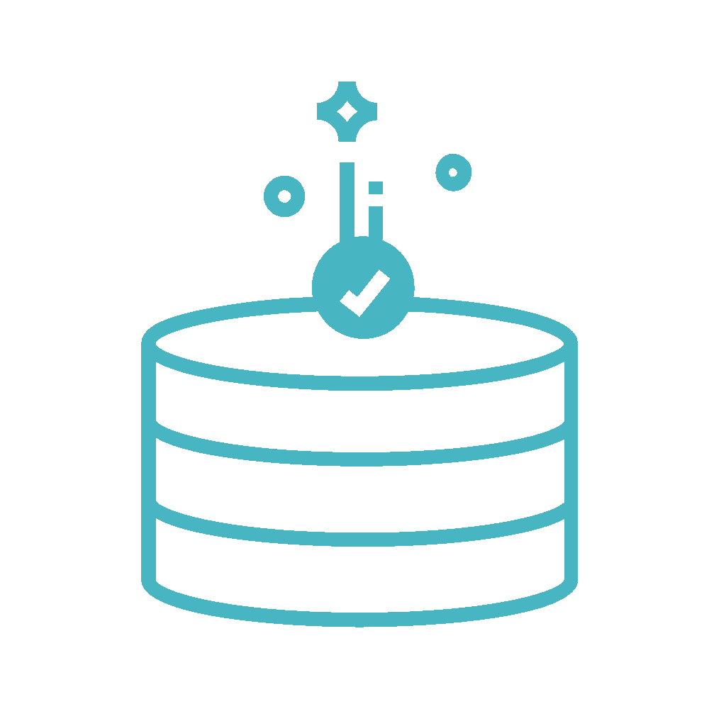

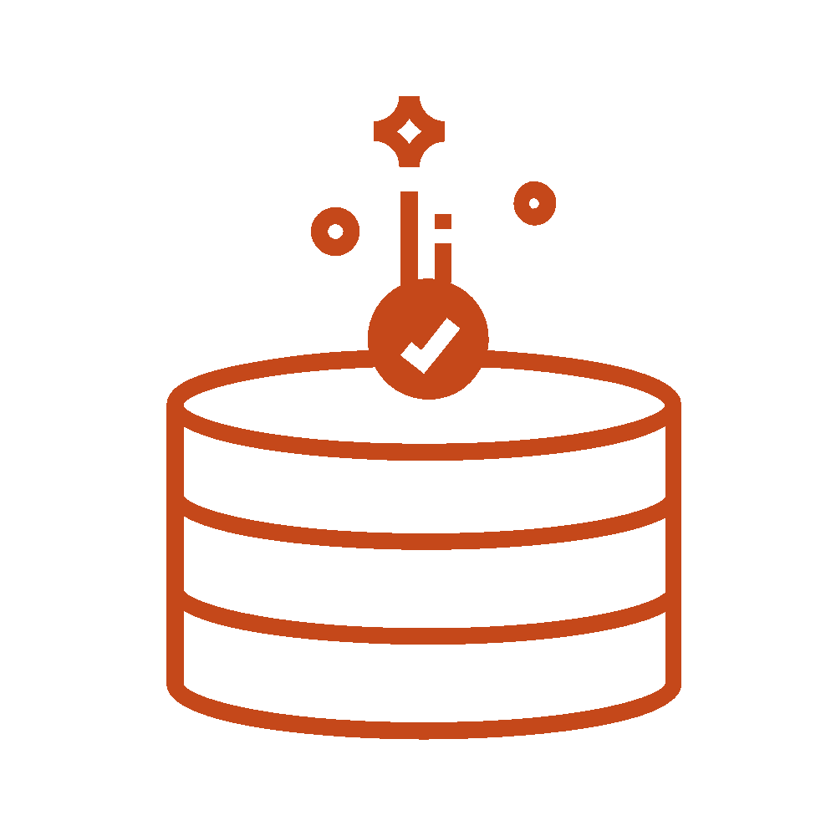
Data reliability challenges with data lakes
Failed production jobs leave data in corrupt state requiring tedious recovery
✗
Lack of schema enforcement creates inconsistent and low quality data
Lack of consistency makes it almost impossible to mix appends and reads, batch and streaming

Slide 33

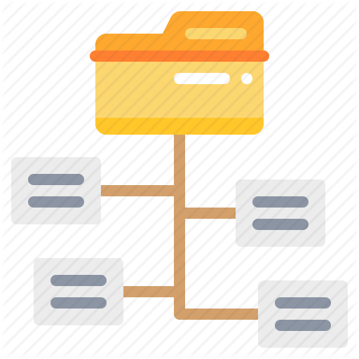
Performance challenges with data lakes
Too many small or very big files - more time opening & closing files rather than reading contents (worse with streaming).
Partitioning aka “poor man’s indexing”- breaks down if you picked the wrong fields or when data has many dimensions, high cardinality columns.
No caching - cloud storage throughput is low (cloud object storage is 20-50MB/s/core vs 300MB/s/core for local SSDs).

Slide 34
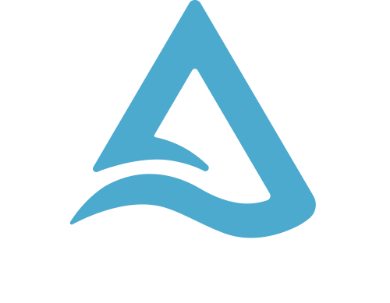
Open Format Based on Parquet
With Transactions
Apache Spark API’s
A New Standard for Building Data Lakes

Slide 35
Delta Lake: makes data ready for analytics
Data Science & ML
Reliability
Performance
Recommendation Engines
Risk, Fraud Detection
IoT & Predictive Maintenance
Genomics & DNA Sequencing

Slide 36
Delta Lake ensures data reliability
Batch
Parquet Files
High Quality & Reliable Data always ready for analytics
Streaming
Updates/Deletes
Transactional Log
ACID Transactions
Schema Enforcement
Unified Batch & Streaming
Time Travel/Data Snapshots
Key Features

Slide 37

Delta Lake optimizes performance
Databricks optimized engine
Highly Performant
queries at scale
Parquet Files
Transactional Log
Indexing
Compaction
Data skipping
Caching
Key Features

Slide 38
Get Started with Delta using Spark APIs
Instead of parquet...
… simply say delta
CREATE TABLE ...
USING parquet
...
dataframe
.write
.format("parquet")
.save("/data")
CREATE TABLE ...
USING delta
…
dataframe
.write
.format("delta")
.save("/data")

Slide 39
Using Delta with your Existing Parquet Tables
Step 1: Convert Parquet to Delta Tables
CONVERT TO DELTA parquet.`path/to/table` [NO STATISTICS] [PARTITIONED BY (col_name1 col_type1, col_name2 col_type2, ...)]
Step 2: Optimize Layout for Fast Queries
OPTIMIZE events WHERE date >= current_timestamp() - INTERVAL 1 day ZORDER BY (eventType)

Slide 40
Upsert/Merge: Fine-grained Updates
%sql
MERGE INTO customers -- Delta table USING updates ON customers.customerId = updates.customerId WHEN MATCHED THEN UPDATE SET address = updates.address WHEN NOT MATCHED THEN INSERT (customerId, address) VALUES (updates.customerId, updates.address)

Slide 41
Time Travel
Reproduce experiments & reports
%sql
-- Lookup data "at given time"
SELECT count(*) FROM events
TIMESTAMP AS OF timestamp
-- Lookup data "at given version"
SELECT count(*) FROM events
VERSION AS OF version
%python
# Lookup data "at given time"
spark.read.format("delta") \
.option("timestampAsOf", ts) \
.load("/events/")
# Lookup data "at given version"
spark.read.format("delta") \
.option("version", version) \
.load("/events/")

Slide 42
Time Travel
Rollback accidental bad writes
%sql
# Restore table to yesterday’s state
RESTORE my_table TO
TIMESTAMP AS OF date_sub(current_date(), 1)

Slide 43
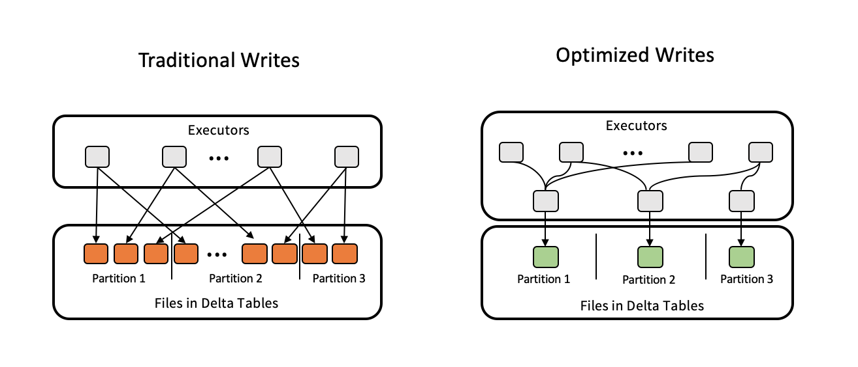
Auto Optimize & Auto Compact
set spark.databricks.delta.properties.defaults.autoOptimize.optimizeWrite = true;
set spark.databricks.delta.properties.defaults.autoOptimize.autoCompact = true;

Slide 44
Getting started with Delta Change Data Feed
Enable CDF for table
%sql
ALTER TABLE ...
SET TBLPROPERTIES (delta.enableChangeDataFeed = true);

Slide 45
Using Delta Change Data Feed
Query changes…
… and store them
%sql
-- Select changes by version
SELECT … FROM table_changes('tableName',
10, -- Start version
12) -- End version
-- Select changes by timestamp
SELECT … FROM table_changes('tableName',
start_ts,
end_ts)
%sql
-- Insert changes to destination table
INSERT INTO TABLE ...
USING DELTA ...
AS
SELECT … FROM table_changes(...)
in SQL, Python, or Scala

Slide 46
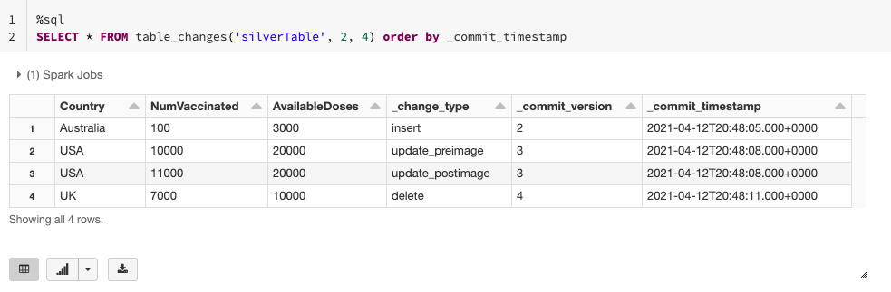
Getting started with Delta Change Data Feed

Slide 47
Delta Lab

Slide 48
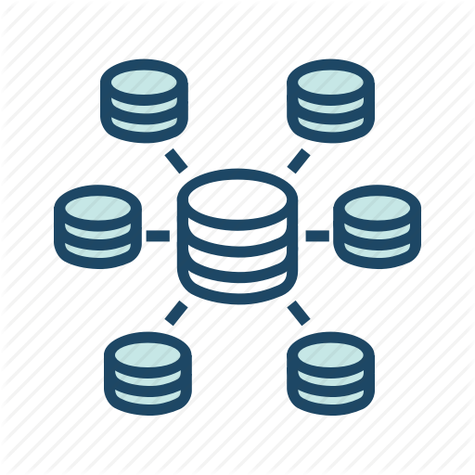






Databricks Ingest: Auto Loader
Load new data easily and efficiently as it arrives in cloud storage
Before
After
Notification Service
Message Queue
Auto Loader
Stream
Batch
CSV,
JSON, TXT…
Data Lake
Delayed schedule
Pipe data from cloud storage into your data lake with Delta Lake as it arrives
“Set and forget” model eliminates complex setup
External Trigger
Airflow file sensor
Gets too complicated for multiple jobs
Launch Blog Post

Slide 49
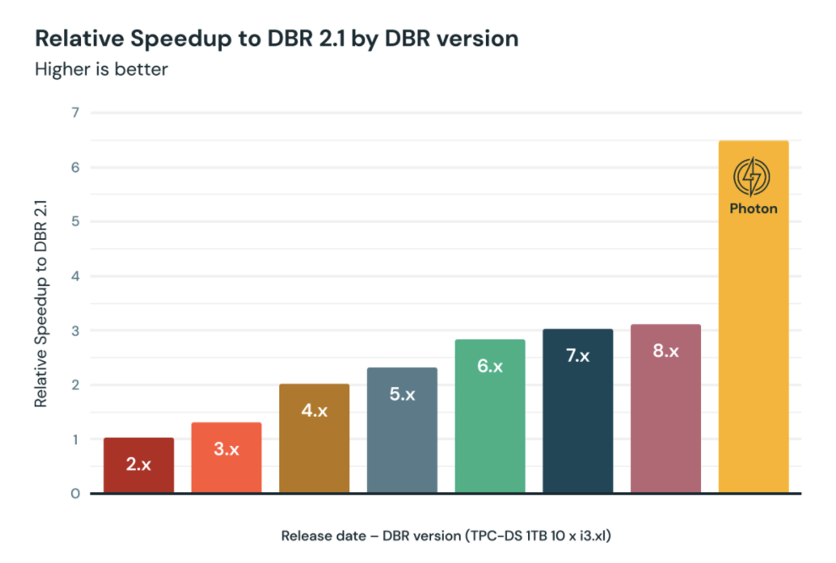
Photon Performance
Supercharging Spark Performance - on Databricks
Faster ETL and query performance
Reduces cloud spend
No code changes
Broad language support
Vs DBR w/o Photon, Photon provides:
Avg query speedup: 2.5x
Workload speedup: 3.7x

Slide 50
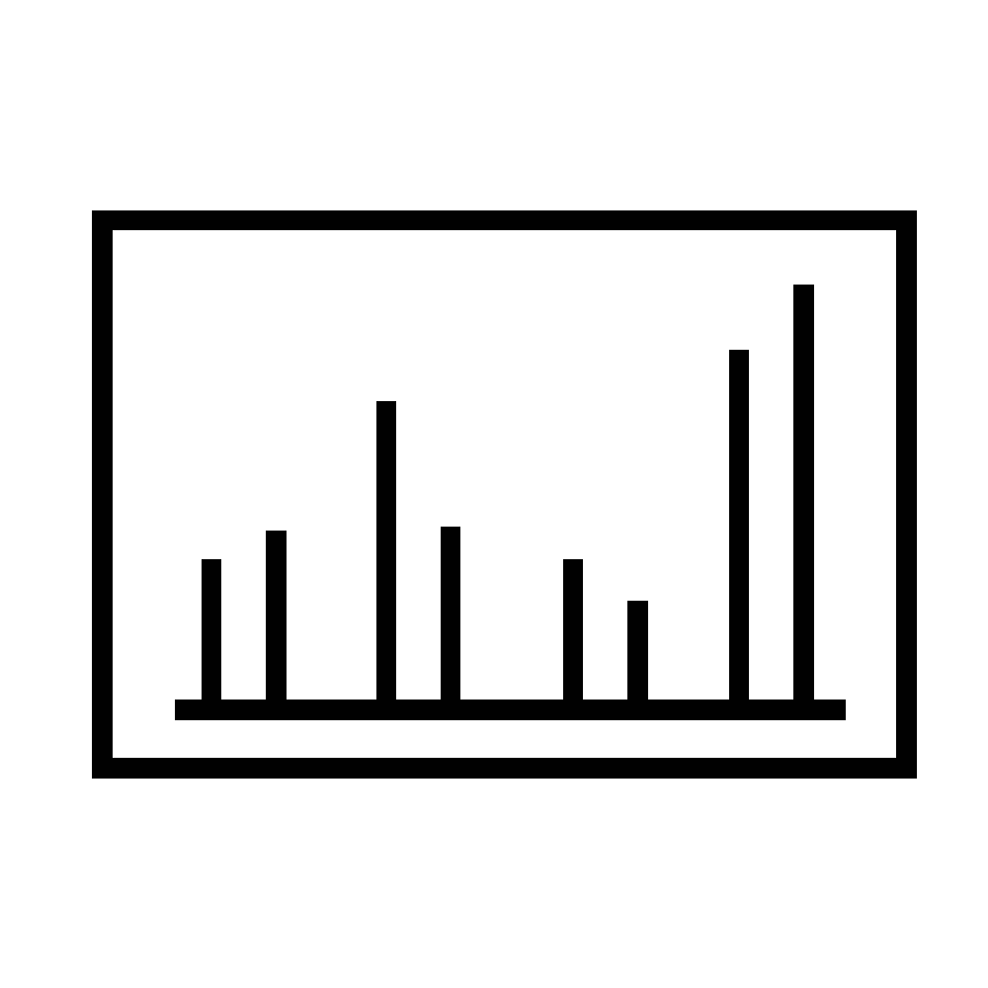

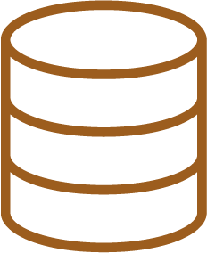
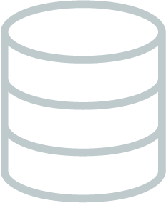
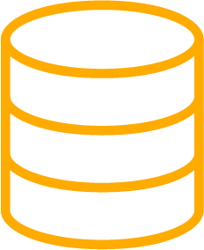

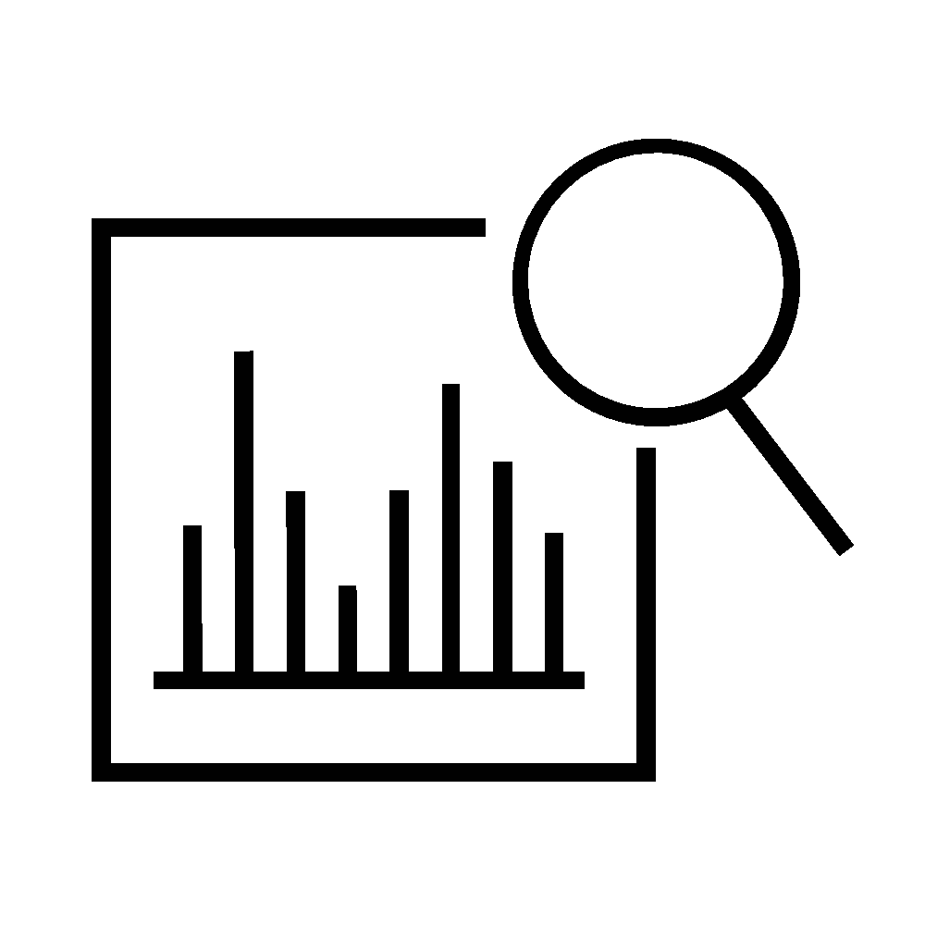
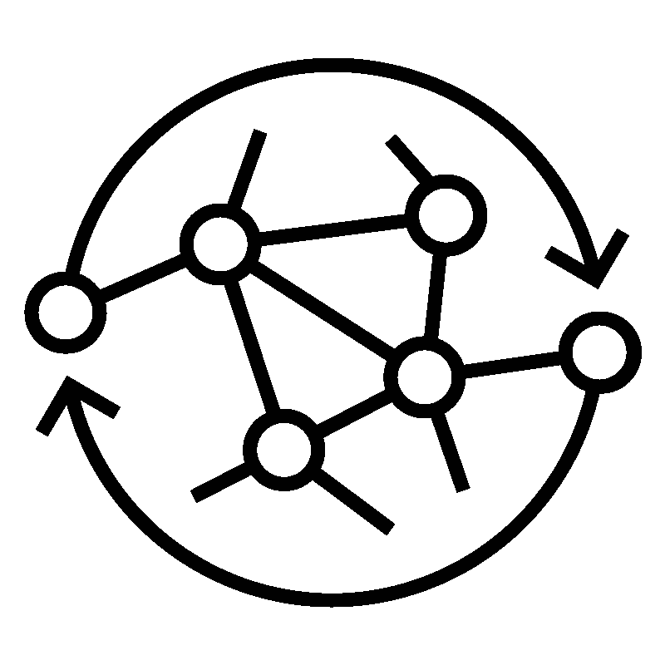
Building the foundation of the Lakehouse
Greatly improve data quality for end users - on your existing data lake
BRONZE
SILVER
GOLD
Streaming Analytics
Kinesis
CSV,
JSON, TXT…
BI & Reporting
Data Lake
Raw Ingestion and History
Filtered, Cleaned, Augmented
Business-level Aggregates
Data Science & ML
Quality

Slide 51





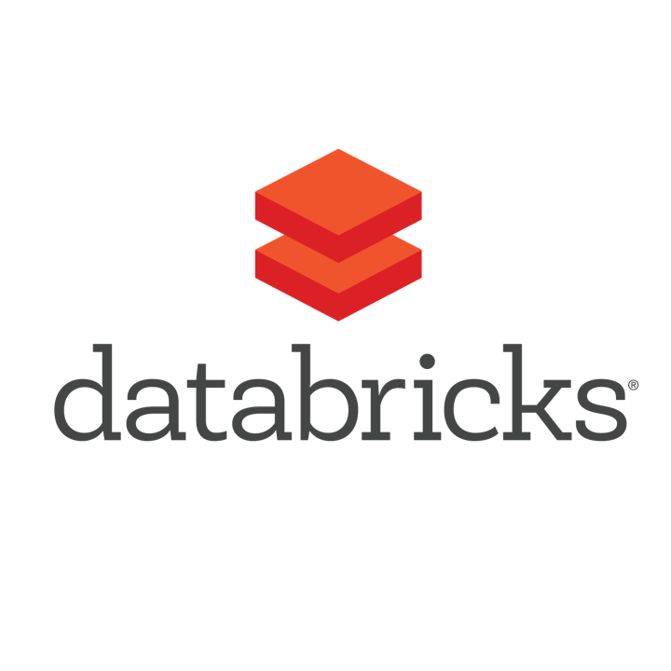





All your data together for all your data use cases
All your data
Reliable data lake
All your use cases
CLICKSTREAM
SQL Dashboards
LOGS
DATABASE
BI Reporting
SFDC
Open format
Open APIs
Open source
IMAGES
Data Science & ML
SENSORS
NOTEBOOK
Existing Data Lake
STREAMING
Data Pipelines
Azure Data Lake Storage
...
RUNTIME

Slide 52





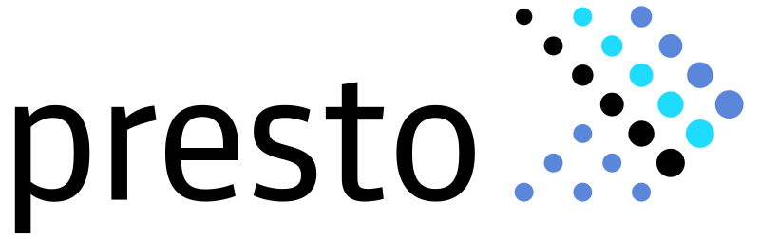
Delta Lake Connectors
Standardize your big data storage with an open format accessible from various tools
Amazon Redshift
Amazon Athena

Slide 53
Delta Live Tables

Slide 54
Declarative ETL pipelines with Delta Live Tables
Source
/* Create a temp view on the accounts table */
CREATE INCREMENTAL LIVE VIEW account_raw AS
SELECT * FROM cloud_files(“/data”, “csv”);
Use intent-driven declarative development to abstract away the “how” and define “what” to solve
Automatically create high-quality lineage and manage table dependencies across the data pipeline
Automatically checks for errors, missing dependencies and syntax errors, and manage pipeline recovery
Bronze
/* Stage 1: Bronze Table drop invalid rows */
CREATE INCREMENTAL LIVE TABLE account_bronze AS
COMMENT "Bronze table with valid account ids"
SELECT * FROM fire_account_raw ...
Silver
/* Stage 2:Send rows to Silver, run validation rules */
CREATE INCREMENTAL LIVE TABLE account_silver AS
COMMENT "Silver Accounts table with validation checks"
SELECT * FROM fire_account_bronze ...
Gold

Slide 55
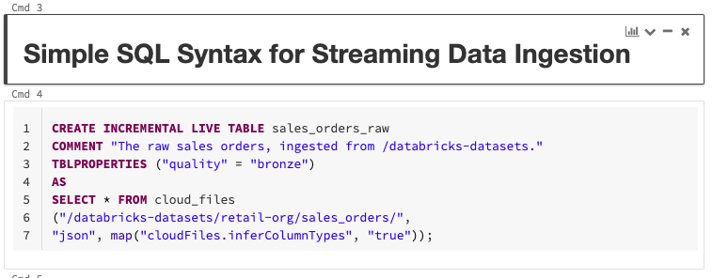
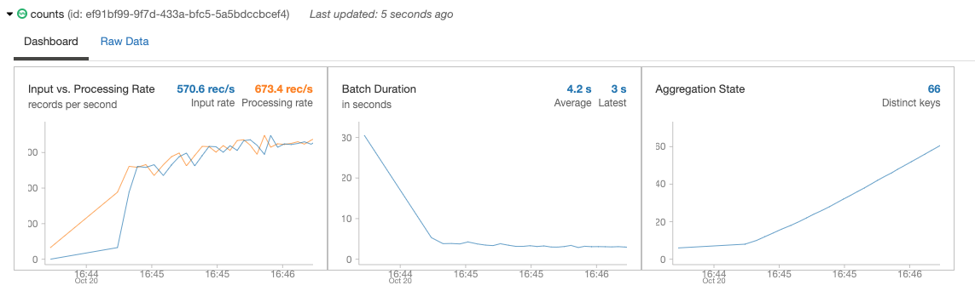
Continuous or scheduled data ingestion with Auto Loader
Incrementally and efficiently process new data files as they arrive in cloud storage
Automatically infer schema of incoming files or superimpose what you know with Schema Hints
Automatic schema evolution
Rescue data column - never lose data again
Schema Evolution
Coming Soon
Coming Soon
✅
JSON
✅
CSV
AVRO
PARQUET

Slide 56

Change data capture (CDC) with Delta Live Tables
Capture row-level changes from any data source supported by DBR, cloud storage, or DBFS
Simpler architecture: build, simple incremental pipelines
Handles out-of-order events
Schema evolution
Process change records (inserts, updates, deletes) incrementally using a simple, declarative “APPLY CHANGES INTO” SQL API
Data Sources
Streaming Sources
Cloud Object Stores
Structured Data
Unstructured Data
Semi-
structured data
Data Migration Services
UPSERT via CDC
UPSERT via CDC
UPSERT via CDC
Bronze
Silver

Slide 57
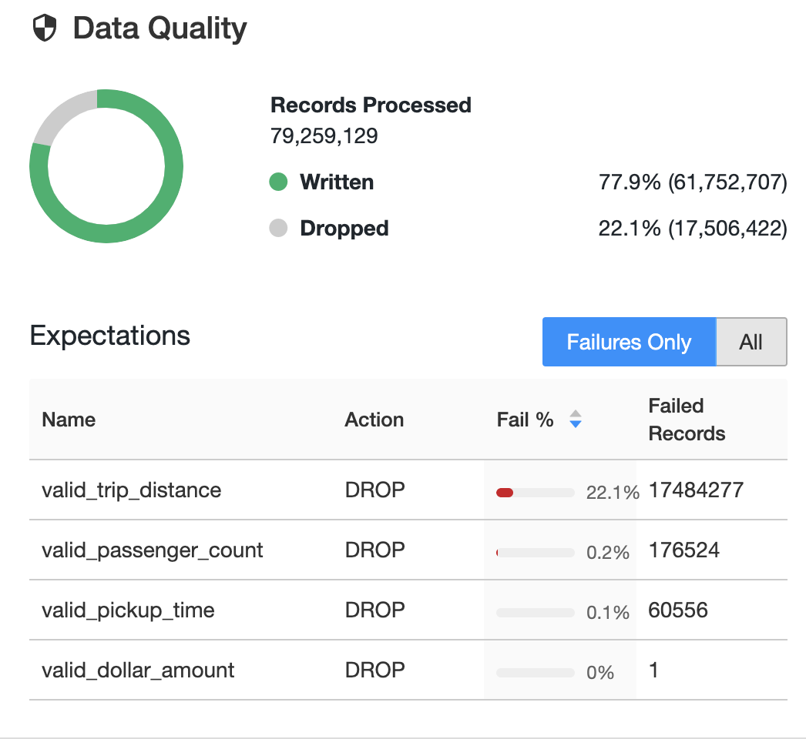
Data quality validation and monitoring with Delta Live Tables
Define data quality and integrity controls within the pipeline with data expectations
Address data quality errors with flexible policies (fail, drop, alert, quarantine)
All data pipeline runs and quality metrics are captured, tracked and reported
/* Stage 1: Bronze Table drop invalid rows */
CREATE INCREMENTAL LIVE TABLE fire_account_bronze AS
( CONSTRAINT valid_account_open_dt EXPECT (acconut_dt is not null and (account_close_dt > account_open_dt)) ON VIOLATION DROP ROW
COMMENT "Bronze table with valid account ids"
SELECT * FROM fire_account_raw ...

Slide 58
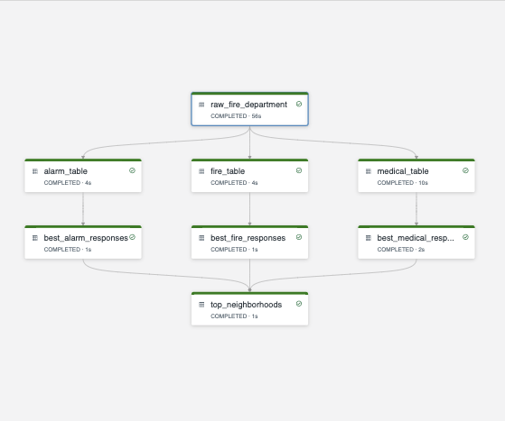
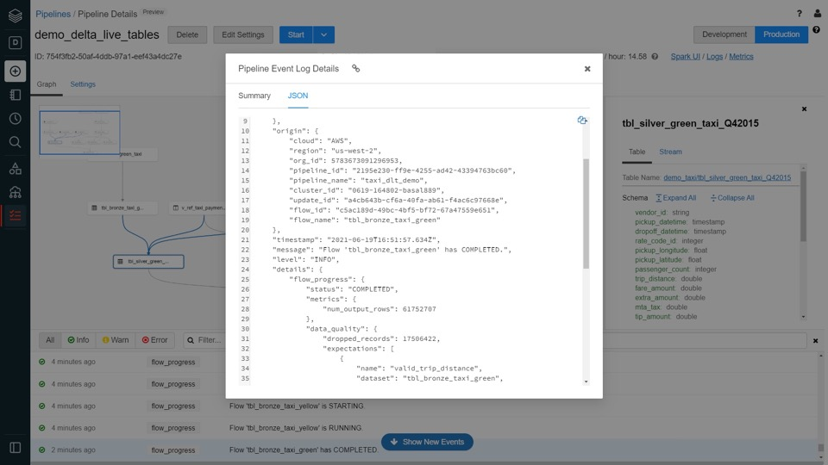
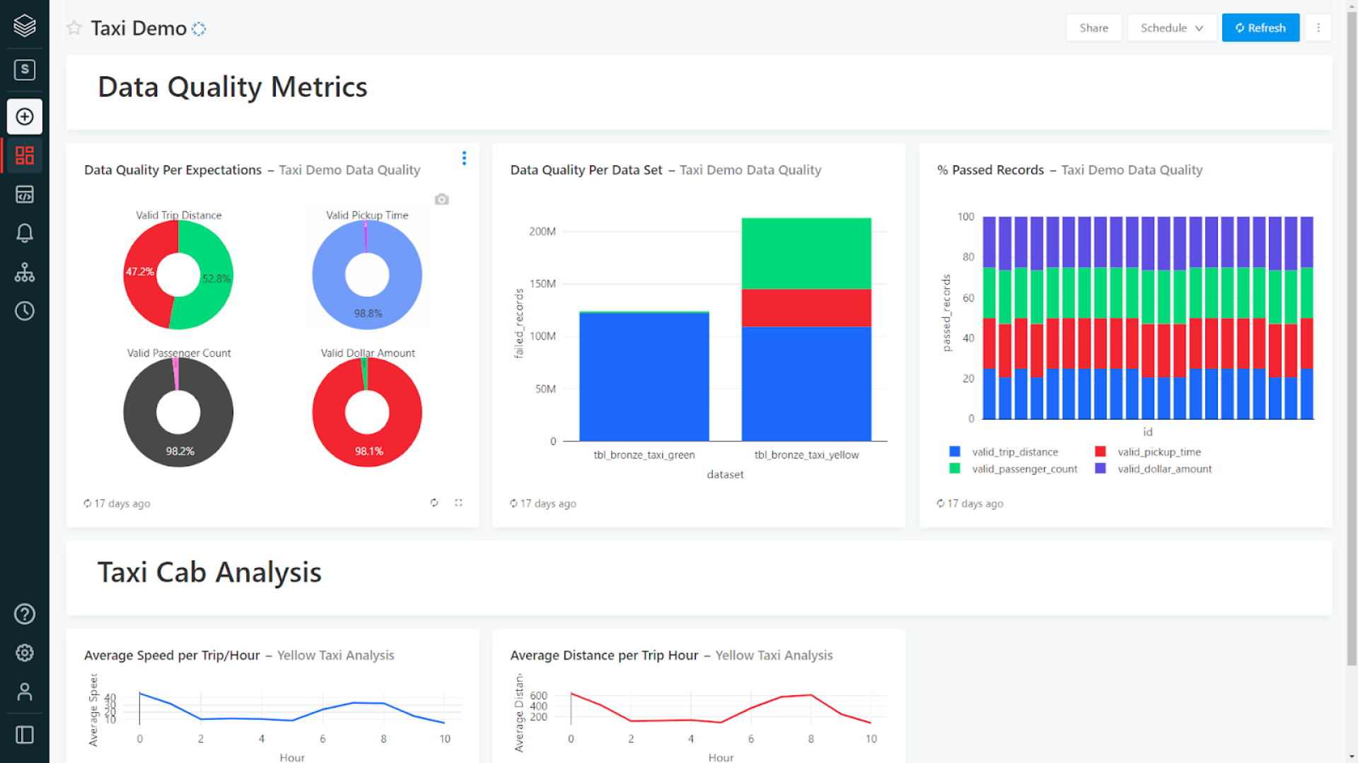
Data pipeline observability in Delta Lives Table
High-quality, high-fidelity lineage diagram that provides visibility into how data flows for impact analysis
Granular logging for operational, governance, quality and status of the data pipeline at a row level
Continuously monitor data pipeline jobs to ensure continued operation
Email alerting using Databricks SQL

Slide 59



Automatic deployments and operations with Delta Lives Table
Complete, parameterized and automated deployment for the continuous data delivery
Reuse ETL pipelines across environments with config files and parameterization
Orchestrates, tests, and monitor end-to-end the data pipeline
Development
Lineage information captured and used
to keep data fresh anywhere
raw
Staging
clean
scored
Production

Slide 60

Automated scaling and fault tolerance with Delta Live Tables
Meet streaming SLOs with backlog-aware scaling decisions - Monitor both, backlog metrics and cluster utilization to scale up or down
Reduce down time with automatic error handling and easy replay
Eliminate maintenance with automatic optimizations of all Delta Live Tables
Execute data pipeline workload on automatically provisioned elastic Apache Spark™-based compute clusters that parallelize jobs as well as minimize data movement
Backlog monitoring
Utilization monitoring
No/Small backlog
& low utilization
Scale
down
Streaming source
Spark executors

Slide 61
Multitask Jobs

Slide 62
Workflow Management on Databricks
Simplify orchestration and management of multi-step workflows
Before
After
External Orchestrator, e.g. Airflow or ADF
Multitask Jobs
Job 1
Job 2.a
Job 1
Job 2.a
Job 3
Job 4
Job 3
Job 4
Job 2.b
Job 2.b
Cost/complexity of maintaining external orchestrator
Hard to monitor/debug
Turnkey orchestration within Databricks
Visibility into job dependencies, debugging, etc.
Airflow and ADF integrations will continue to be supported

Slide 63
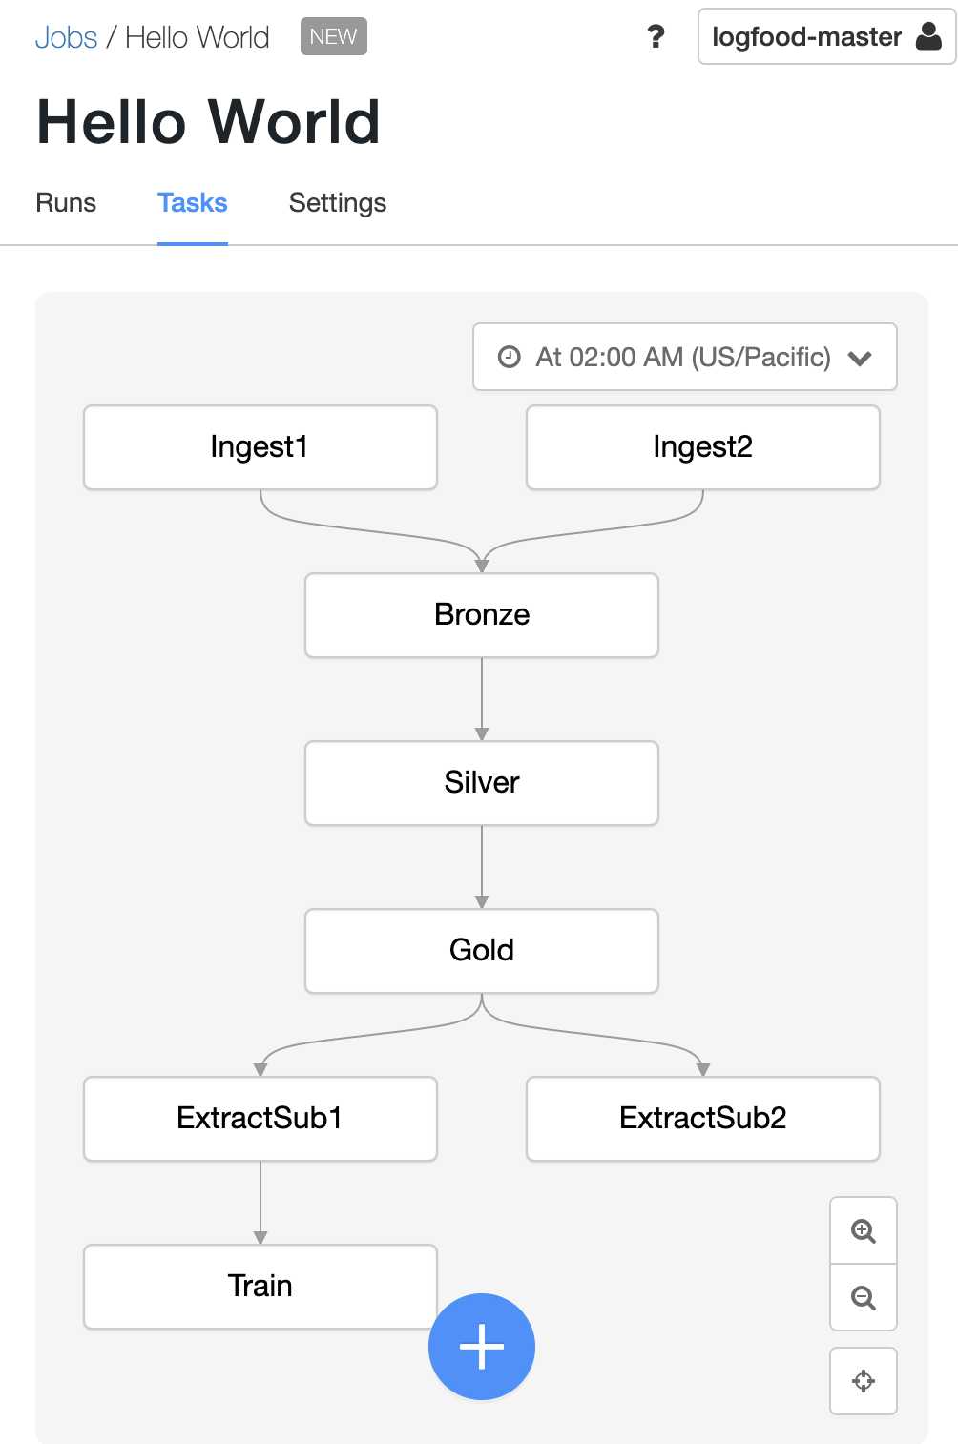
Easy orchestration for data and ML workloads
Job
What is it? Easy creation, scheduling, and orchestration of your code in DAGs (Directed Acyclic Graphs)
Key features
Simplicity: No-code creation and monitoring in the UI
Fully integrated in Databricks platform, making inspecting results, debugging faster
Orchestrate and manage workloads in multi-cloud environments
Reliability of proven Databricks scheduler
Schedule
DAG of tasks

Slide 64
Partner Connect

Slide 65
Delta Live Tables
Lab

